Slide 1
LIBRARY MANAGEMENT SYSTEM
group mambers name:
samual luswata
moses niyonshuti
zinash negga
wagobera kedi

Slide 2
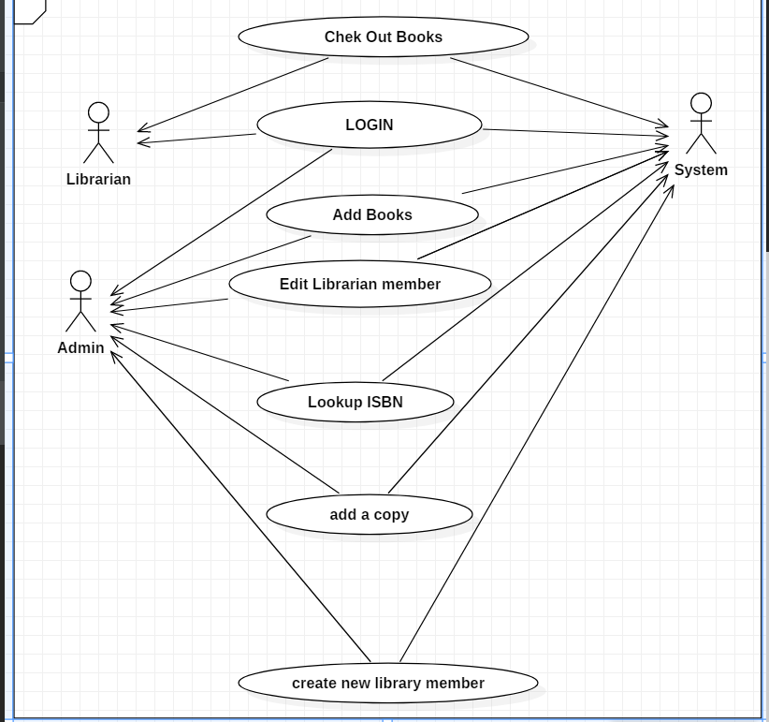
Library management system use case diagram

Slide 3
Sci points
The whole is greater than the sum of the parts.
For example if this project is being done in a team, the benefits are we have different experience some one can have good experience GUI another person has great experience how to do sequence diagram, we can work together, and encourage each to have more energy. The individuals coming together producing more than what we could on their own.

